Slide 1
Statistical Moments

Slide 2
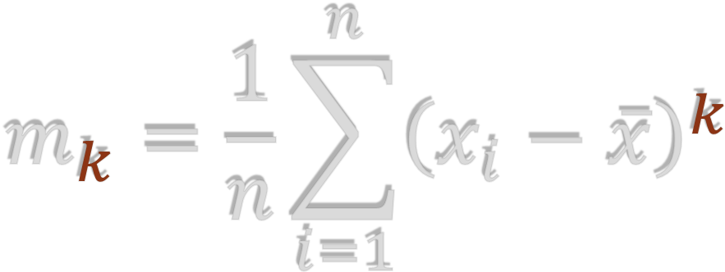


First moment
General formula
$$m_{1}=\frac{1}{n}\sum_{i=1}^{n}{x_{i}}$$
Second moment
$$m_{2}=\frac{1}{n}\sum_{i=1}^{n}{{\left(x_{i}−\overline{x}\right)}^{2}}$$

Slide 3


First moment
General formula
Unstandardized statistical moments
$$m_{1}=\frac{1}{n}\sum_{i=1}^{n}{x_{i}}$$
Second moment
$$m_{2}=\frac{1}{n}\sum_{i=1}^{n}{{\left(x_{i}−\overline{x}\right)}^{2}}$$

Slide 4




Mean – Center
Standardized statistical moments
$$m_{1}=\frac{1}{n}\sum_{i=1}^{n}{x_{i}}$$
Variance – Spread
$$m_{2}=\frac{1}{n}\sum_{i=1}^{n}{{\left(x_{i}−\overline{x}\right)}^{2}}$$
Skewness – Dispersion asymmetry
$$m_{3}=\frac{1}{{nσ}^{3}}\sum_{i=1}^{n}{{\left(x_{i}−\overline{x}\right)}^{3}}$$
Kurtosis – Tail "heaviness"
$$m_{4}=\frac{1}{{nσ}^{4}}\sum_{i=1}^{n}{{\left(x_{i}−\overline{x}\right)}^{4}}$$

Slide 5
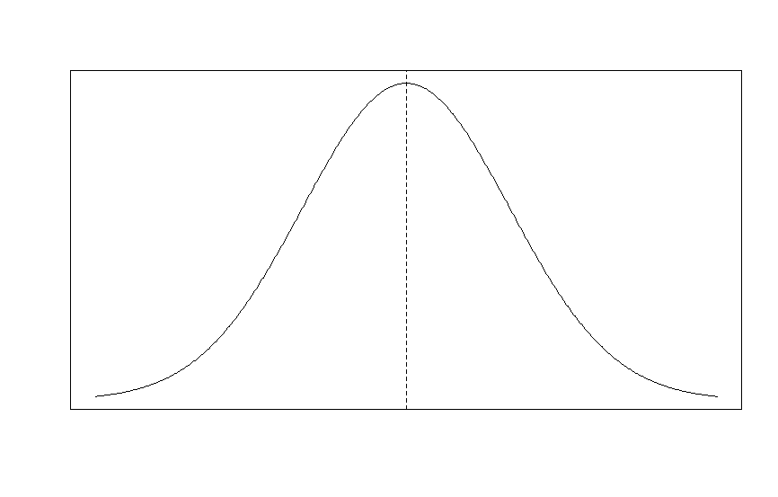
Mean – Center
Standardized statistical moments
$$m_{1}=\frac{1}{n}\sum_{i=1}^{n}{x_{i}}$$

Slide 6
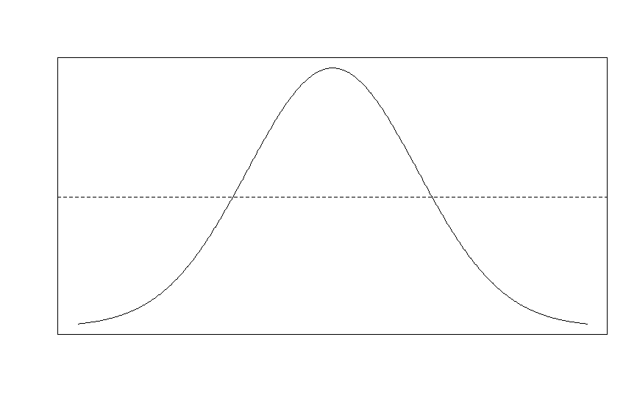

Standardized statistical moments
Variance – Spread
$$m_{2}=\frac{1}{n}\sum_{i=1}^{n}{{\left(x_{i}−\overline{x}\right)}^{2}}$$

Slide 7
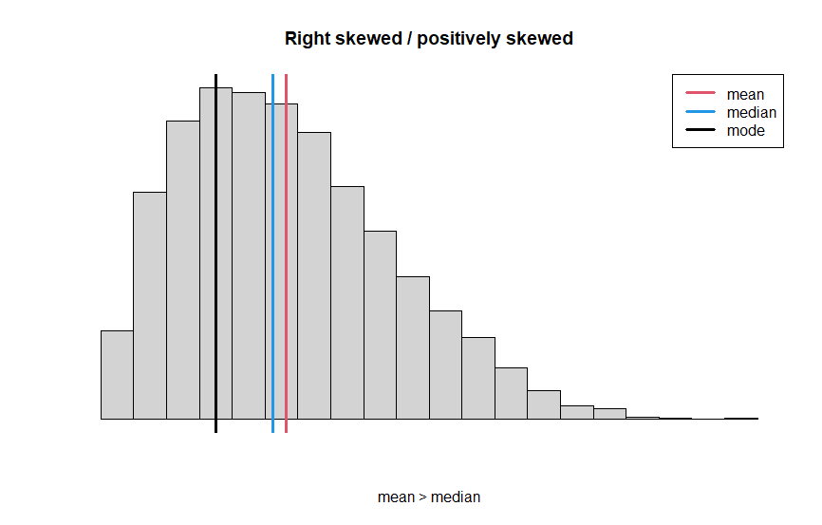
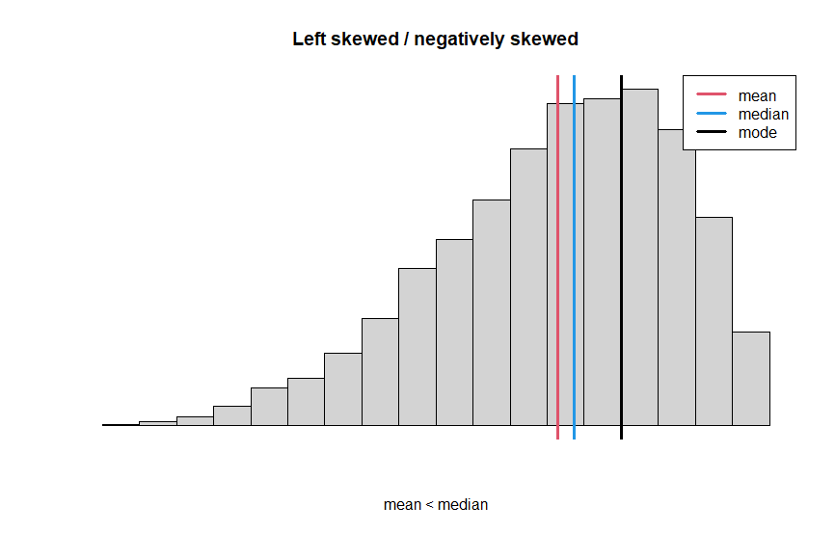

Standardized statistical moments
Skewness – Dispersion asymmetry
$$m_{3}=\frac{1}{{nσ}^{3}}\sum_{i=1}^{n}{{\left(x_{i}−\overline{x}\right)}^{3}}$$

Slide 8
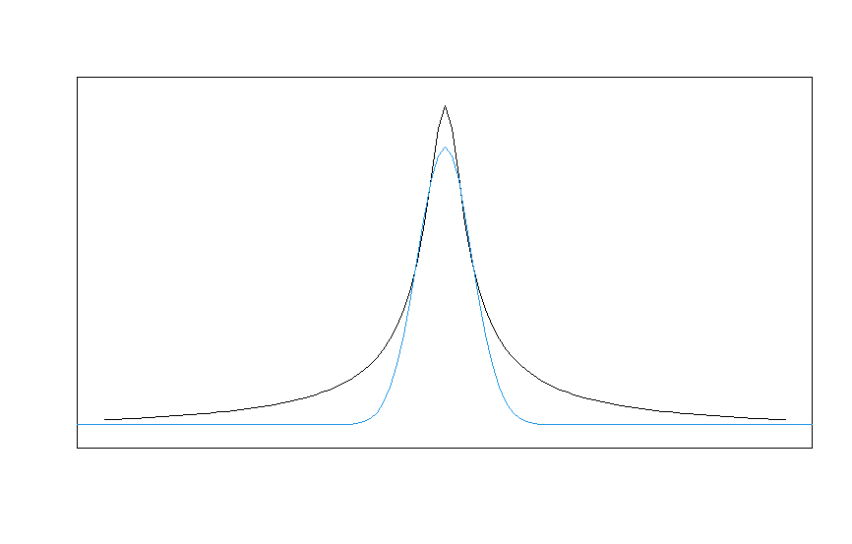

Standardized statistical moments
Kurtosis – Tail "heaviness"
$$m_{4}=\frac{1}{{nσ}^{4}}\sum_{i=1}^{n}{{\left(x_{i}−\overline{x}\right)}^{4}}$$

Slide 9


Mean – Center
Standardized statistical moments
$$m_{1}=\frac{1}{n}\sum_{i=1}^{n}{x_{i}}$$
Variance – Spread
$$m_{2}=\frac{1}{n}\sum_{i=1}^{n}{{\left(x_{i}−\overline{x}\right)}^{2}}$$
Skewness – Dispersion asymmetry
$$m_{3}=\frac{1}{{nσ}^{3}}\sum_{i=1}^{n}{{\left(x_{i}−\overline{x}\right)}^{3}}$$
Kurtosis – Tail "heaviness"
$$m_{4}=\frac{1}{{nσ}^{4}}\sum_{i=1}^{n}{{\left(x_{i}−\overline{x}\right)}^{4}}$$

